Slide 1
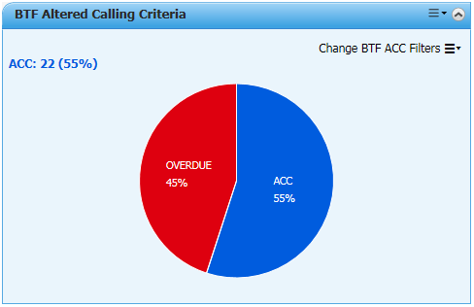
BTF ACC (Altered Calling Criteria)
Custom MPage component to assist Clinicians to quickly identify High Risk patients who have altered calling criteria recorded via BTF in eMR
Features:
Display Real Time Data (from “cust_mp_altered_criteria” table)
Responsive Filter Menu
Interactive Pie Chart Graph Display
Dynamic presentation of data based on menu filter selections
Detailed Patient List pop-up
Individual Patient hyperlinks

Slide 2
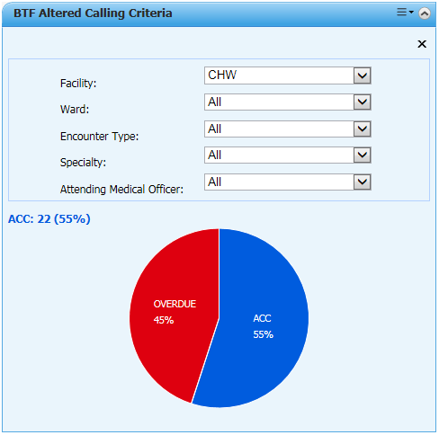
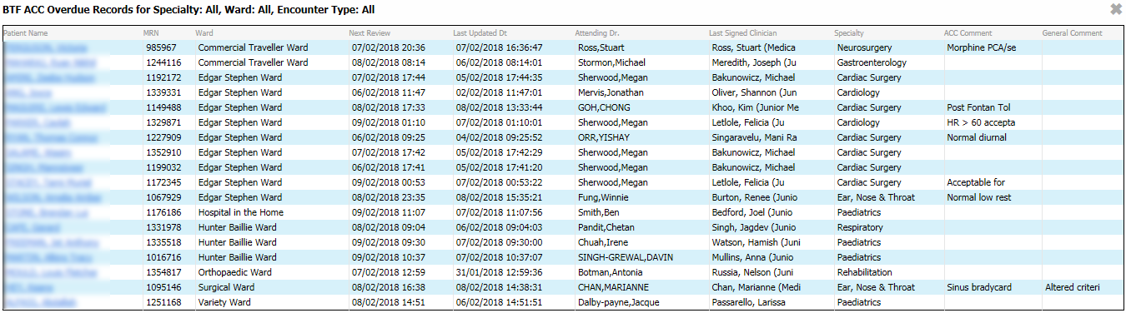
Interactive and Responsive Design
Latest MPage Development techniques
Responsive Menu
Interactive Pie Chart Graph
Pop-up Patient List
Active Patient Hyperlinks

